Slide 1
Ocular Disease Detection and Classification
using Convolutional Neural Network and Transfer Learning
Rashu Shrestha (23348/076)
Safalta Khanal (23354/076)
Date: 21/03/2024

Slide 2
Overview
Introduction
Problem Statement
Objectives
Literature Review
Tools/Platforms Used
System Architecture
Project Deliverables
Critical Analysis
Future Enhancements
Conclusion

Slide 3
Introduction
At least 2.2 billion individuals suffer from visual impairment, much of which might have been avoided or is untreated.
Cataract, Glaucoma, and Diabetic Retinopathy can cause vision impairment and even vision loss.
If detected and diagnosed at an early stage, Cataracts, and Glaucoma can be cured. Likewise, treatments can slow or stop the progression of diabetic retinopathy.

Slide 4
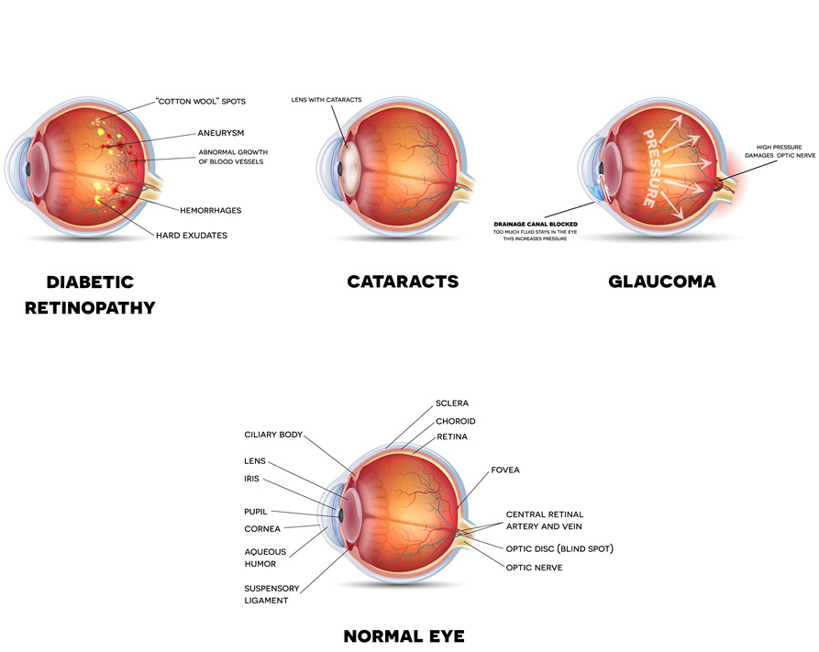
Our project, a web-based system integrated with a Deep Learning model, can be used for the detection and classification of common eye diseases. This system offers a convenient and accurate method for categorizing conditions such as cataract, glaucoma, diabetic retinopathy, and normal eye status.

Slide 5
Problem Statement
Limited access to eye care services.
Absence of integrated healthcare systems leads to delayed diagnosis of glaucoma, diabetic retinopathy, and cataracts, impacting vision health.
Lack of widespread screening programs and trained personnel delays the detection and treatment of glaucoma, diabetic retinopathy, and cataracts, sometimes leading to vision loss.

Slide 6
Objectives
To develop an eye disease detection and classification model that can differentiate between Cataracts, Glaucoma, Diabetic Retinopathy, and Normal Eyes.
To build a web application for classifying specified eye diseases using deep learning algorithms and comparing their accuracies.

Slide 7
Literature Review
Multi-class multi-label ophthalmological disease detection using transfer learning based convolutional neural network
Impact Factor: 5.1
Published Year: 2020
Journal Name | Data Source | Algorithm | Result | Validation | Research Gap
Biomedical Signal Processing and Control | Ocular Disease Intelligent Recognition (ODIR) database | Two transfer learning-based models with four CNN architectures. | VGG16 in the research outperformed existing methods regarding F1-score, AUC, and the total number of training parameters. | Models were evaluated online on the Grand Challenge competition website for the ODIR database | Incorporate AI techniques to provide insights into the model's decision-making process.
Automatic detection of 39 fundus diseases and conditions in retinal photographs using deep neural networks
Impact Factor: 16.6
Published Year: 2021
Nature Communications | Joint Shantou International Eye Center (JSIEC), the Lishui Eye Disease Randomized Controlled Trial System (LEDRS), the Early Treatment Diabetic Retinopathy Study (ETDRS), and the Eye Picture Archive Communication System (EyePACS) in the United States. | Deep learning platform was developed utilizing convolutional neural networks | Classification of 39 different forms of retinal fundus illnesses especially well in the high-specificity, high-sensitivity detection of referable diabetic retinopathy (DR). | Algorithm testing and implementation details scrutiny were done as a verification process along with measuring metrics such as accuracy, sensitivity, and specificity. | Insufficient image data for training, challenges in accurately detecting lesions, particularly DR1, and the reliance solely on fundus photography for diagnosis

Slide 8
Applications of deep learning in fundus images: A review
Impact Factor: 10.9
Published Year: 2021
Journal Name | Data Source | Algorithm | Result | Validation | Research Gap
Medical Image Analysis | EyePACS, Inoveon, AREDS, UK Biobank, and hospitals in India. | Deep learning methods, specifically Convolutional Neural Networks (CNNs), Generative Adversarial Networks (GANs), and Residual Networks. | The deep learning models hold the potential for enhancing the diagnosis and grading of ophthalmic diseases from fundus images while addressing current limitations and proposing solutions to improve model performance in early screening. | Different performance metrics like accuracy, sensitivity, specificity, and AUC, were analyzed along with comparing their diagnostic performance with human experts. | This paper analyzes the necessity for enhanced data management and reporting practices.
Automated detection of mild and multi-class diabetic eye diseases using deep learning
Impact Factor: 5.017
Published Year: 2020
Health Information Science and Systems | Open-access platforms like DRISHTI-GS, Messidor, and Messidor-2, | VGG16 and InceptionV3 on ImageNet. | The study compared pre trained CNN models through fine-tuning, and focused on mild and multi-class DL algorithms for automated detection of Diabetic Eye Disease, achieving sensitivity within the range of 85% to 98%. | British Diabetic Association (BDA) standards was fulfilled indicating sufficient performance. | More complex and advantageous identification of multi-grade diseases can be performed.

Slide 9
Detecting Cataract Using Smartphones
Impact Factor: 3.4
Published Year: 2021
Journal Name | Data Source | Algorithm | Result | Validation | Research Gap
IEEE Journal of Translational Engineering in Health and Medicine | Axis Scientific 7-Part Human Eye model | A novel luminance transformation algorithm was applied to extract lens image features. Support Vector Machines (SVM) were used as the classification method. | The proposed method achieved a diagnosis accuracy of 96.6%, specificity of 93.4%, and sensitivity of 93.75% for detecting cataracts. | Statistical hypothesis tests were conducted to validate the difference between healthy and diseased luminance values. | Further clarification is needed on the re-targetable application platform mentioned for implementation on various smartphones.

Slide 10









Tools Used

Slide 11
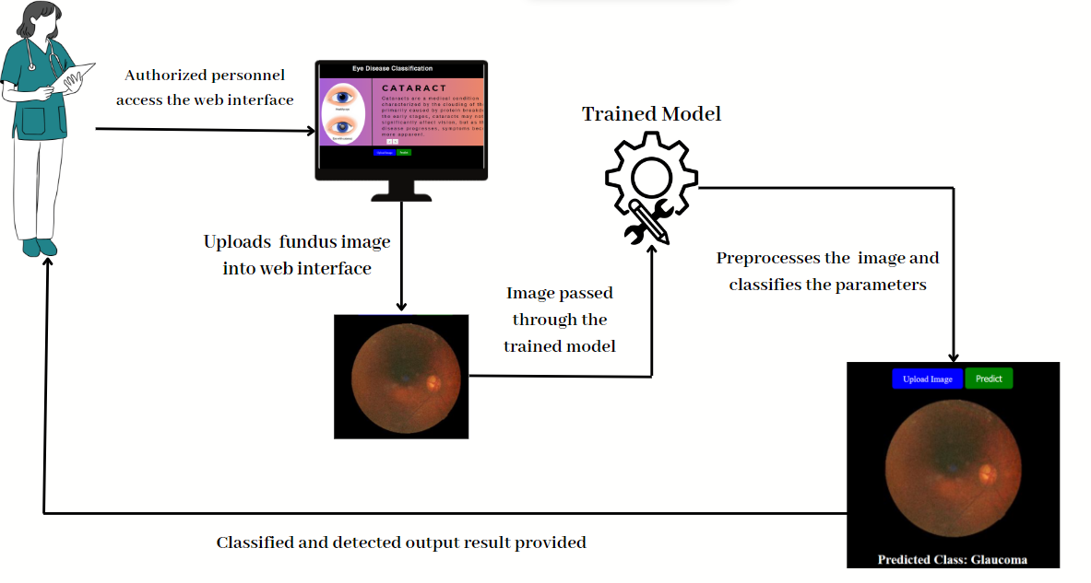
System Architecture

Slide 12
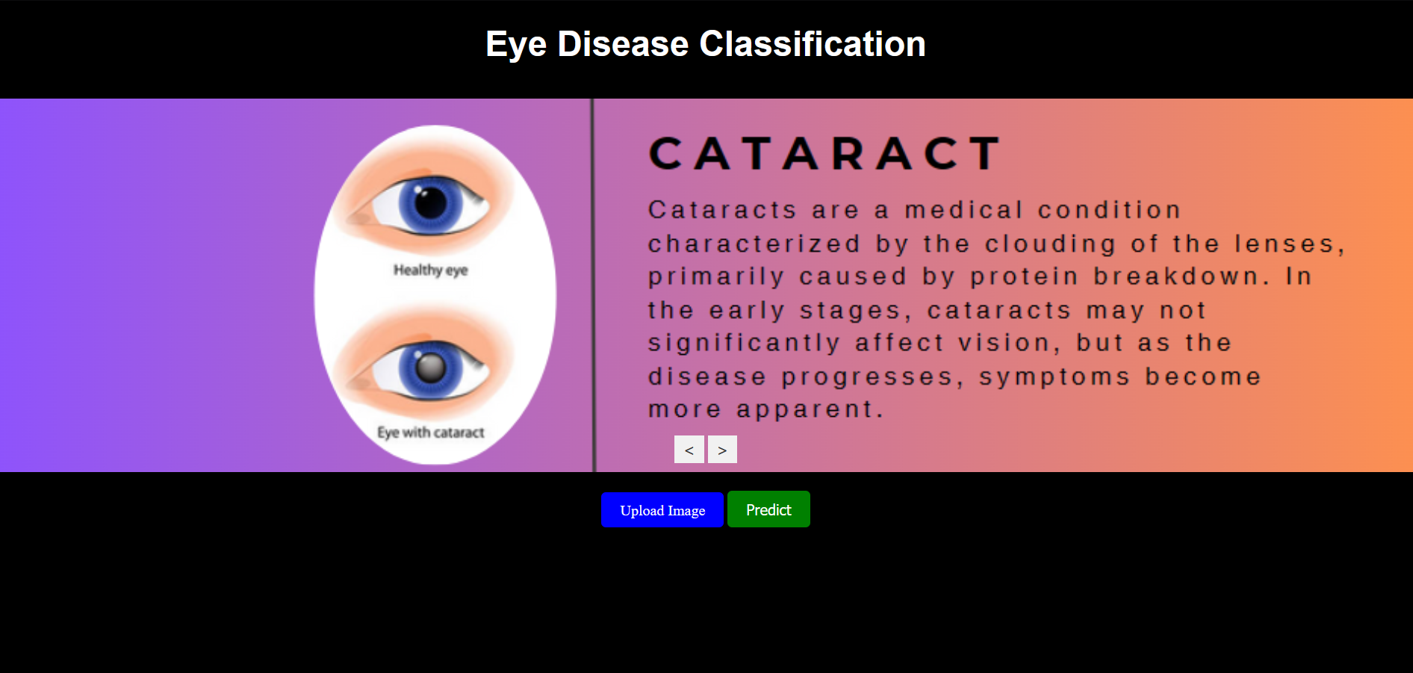
Deliverables

Slide 13
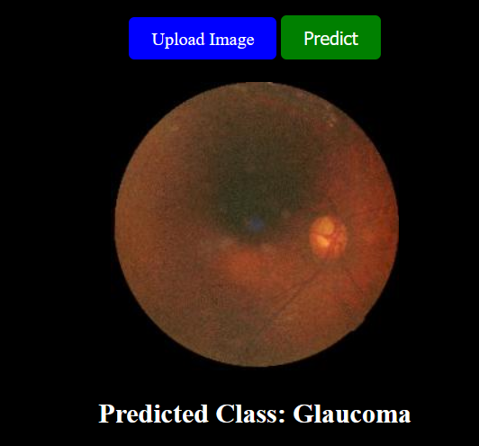
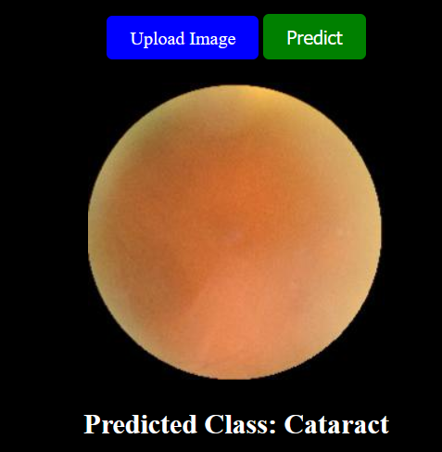

Slide 14
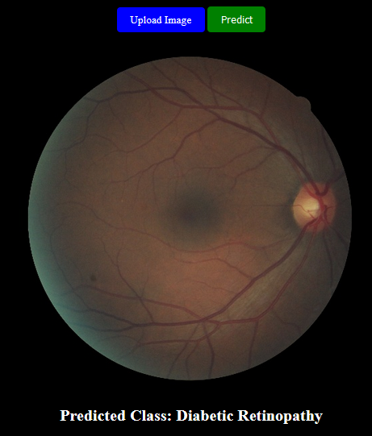
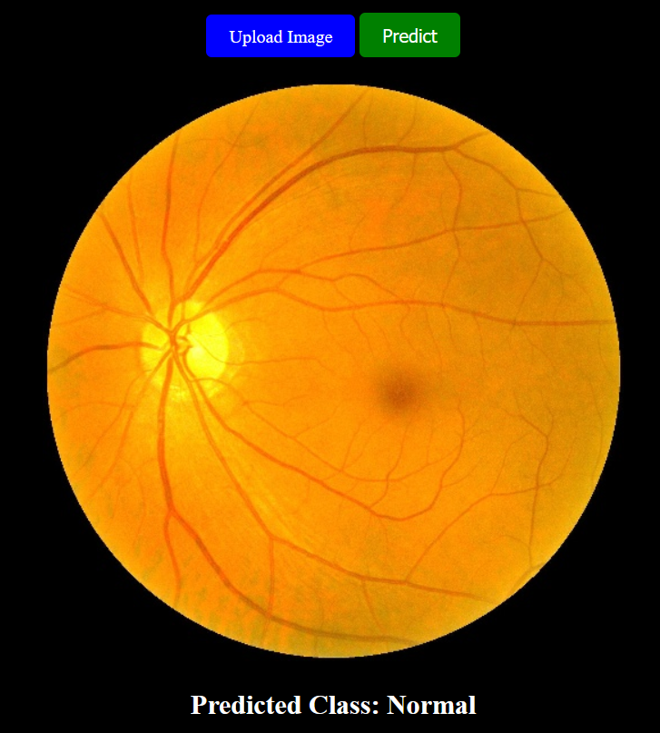

Slide 15
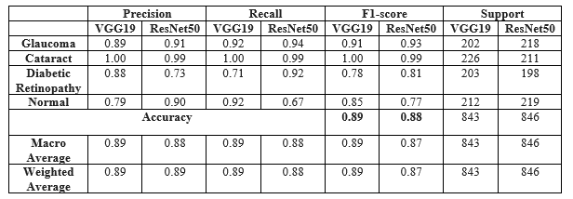
Critical Analysis
In this project, we achieved the highest accuracy of 89% on the test dataset using the VGG-19 model. This approach proved to be the most effective in processing fundus images for ocular disease detection and classification.

Slide 16
Future Enhancements
Expanding the disease classes and include diseases such as AMD, Hypertension, Pathological Myopia, etc.
Enable real-time diagnosis.
Implementing Optical Coherence Tomography (OCT) images to detect cataracts.

Slide 17
Conclusion
The models VGG19 and ResNet50 were trained on the datasets and the best model was used to predict and classify the eye disease. VGG19 outperformed with an accuracy of 89%.
The current system's training data is limited. To improve results, future projects should use larger datasets, leading to better accuracy.

Slide 18
Project Demo
Demo

Slide 19
Thank You!

